Slide 1
Project Vardhusa – A cognitive bank assist system
By:
Akshaya BASP

Slide 2
People who have been identified as Semi-illiterates
64.8%
Total Semi-illetrate
73.3%
Male
53.7%
Female
Based on states from census of India

Slide 3
Money Lost due to financial illiteracy
58.8%
10.12%
11.63%
10.12%
Based on states from Financial educators council of India

Slide 4
Common problem faced by semi-illiterates in banks:

Slide 5
Problems due to Financial illiteracy

Slide 6

Our Approach to solution
पैसे

Slide 7
Workflow
Input
Information Encoding
Multistep Reasoning
Authentication Process
Request Acceptance
Output

Slide 8
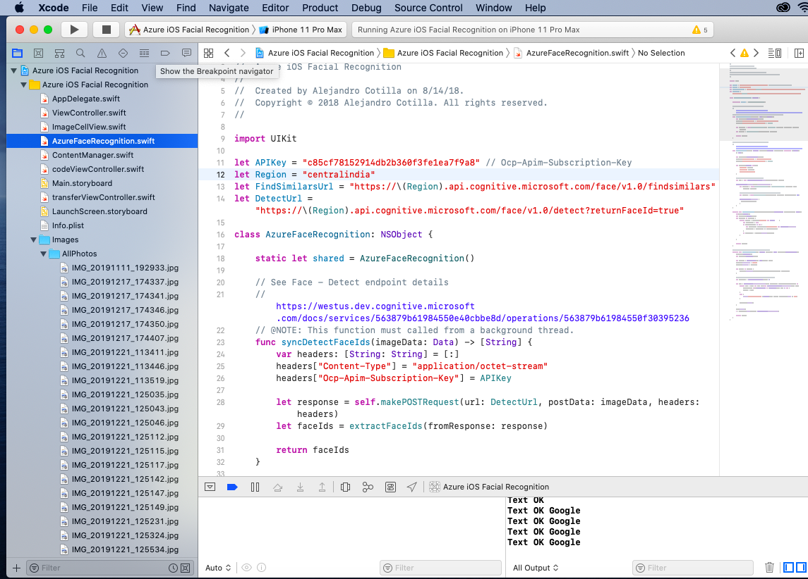
Implementation
Azure Cognitive Service Face API

Slide 9
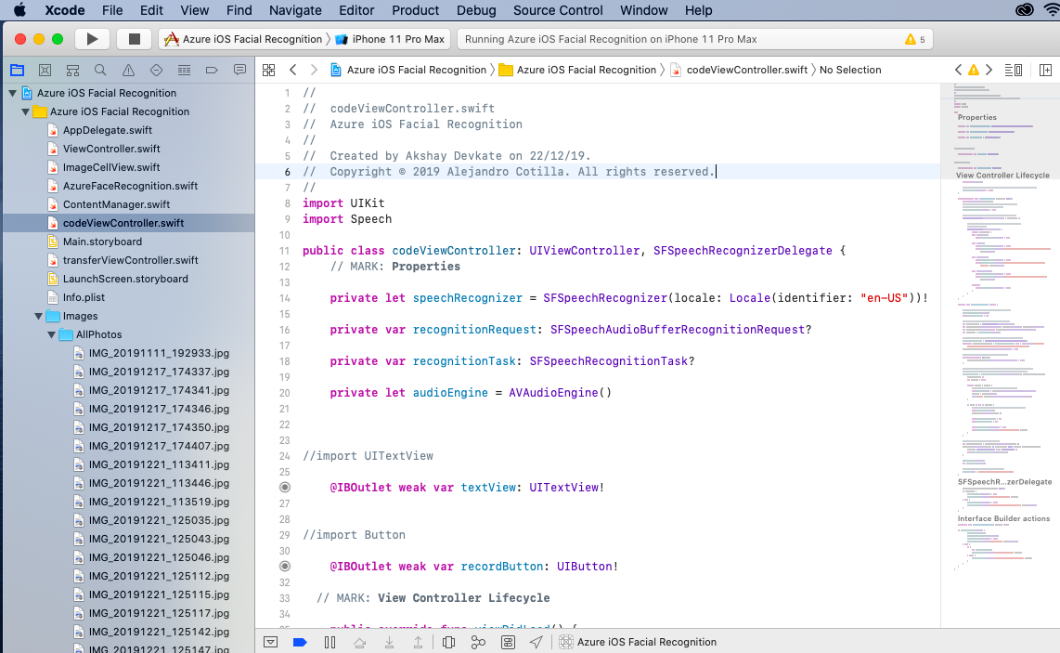
Cont.
Cognitive service Speech recognition

Slide 10
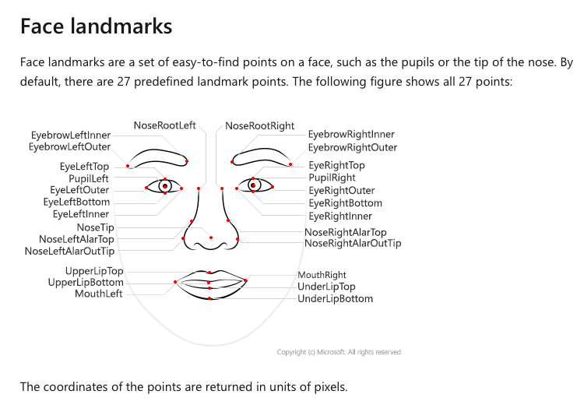
Features Identified by Azure Face API

Slide 11
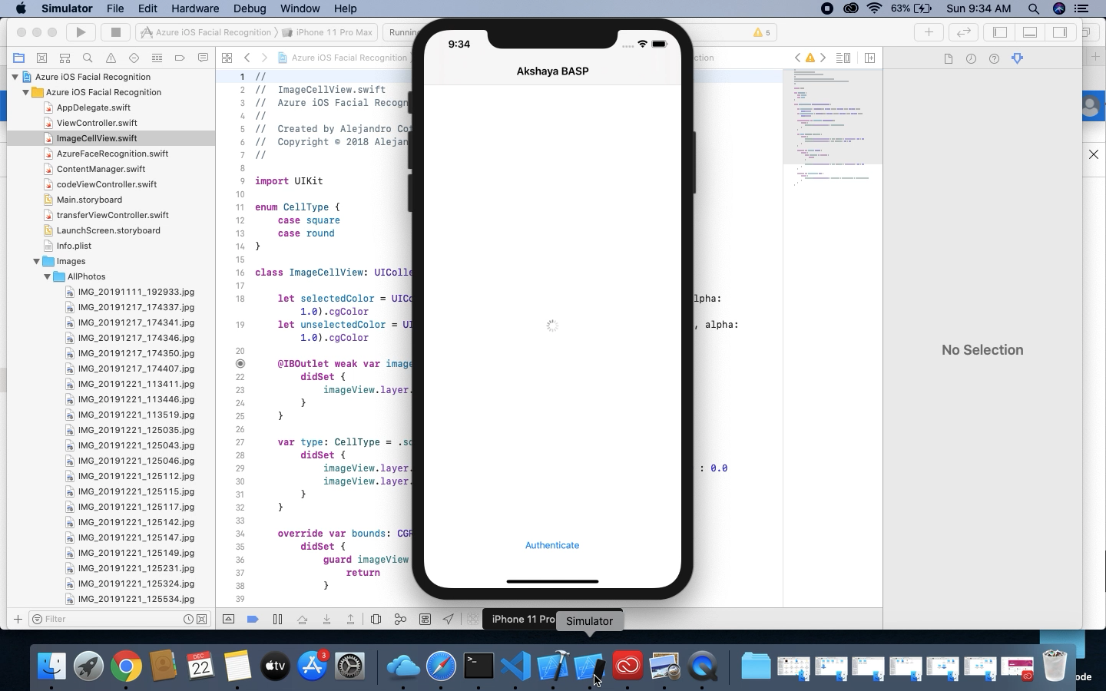
Demo Video

Slide 12
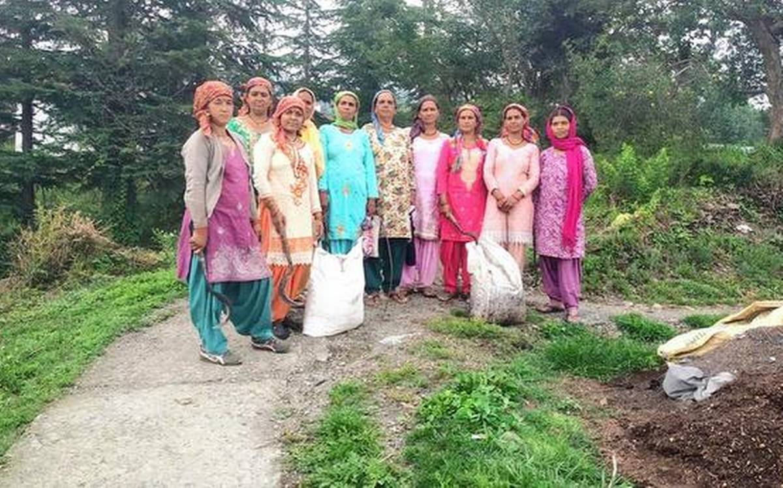
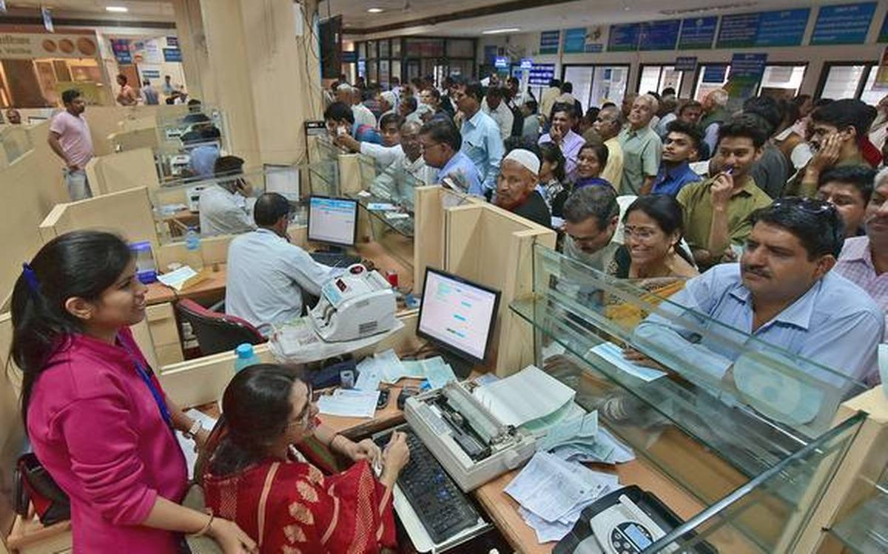
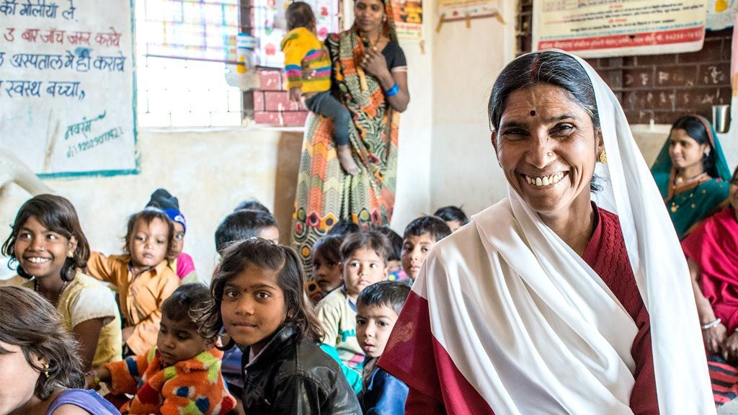
Benefits of Project Vardhusa

